Slide 1
BLOOD BANK MANAGEMENT SYSTEM
-Ponaalagar O K (23ALR064)

Slide 2
Objective:
To manage blood donors efficiently.
Ensure real-time access to donor and blood availability
information.
Automate the process of blood donation, requests
and tracking.
Minimizing human errors in blood donation records.
Connecting those who need blood with those are ready
to donate blood

Slide 3




Tech Stack
Back-end
Database
Bootstrap
Front-end

Slide 4
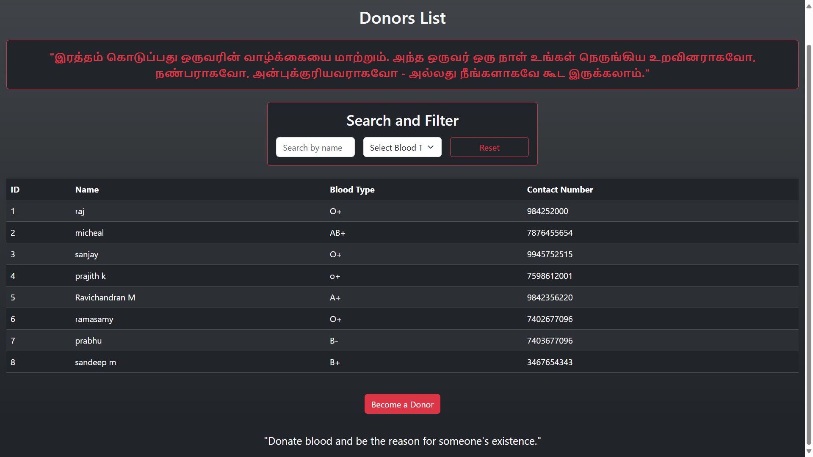
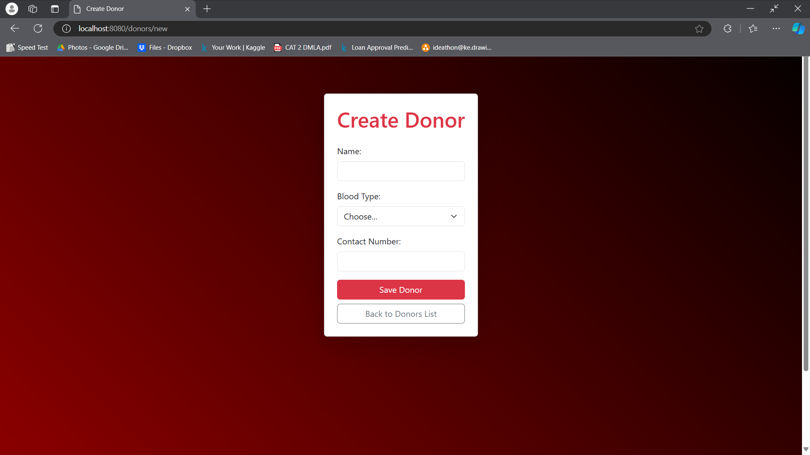
Final Design
Home page
Donar entry page
Code link : https://github.com/ponaalagar/javaMicroProject.git

Slide 5
References
Books:
"Java Programming" by Herbert Schildt
"Spring in Action" by Craig Walls
Websites:
Java Documentation: https://docs.oracle.com/javase/tutorial/
Spring Boot Reference Guide: https://docs.spring.io/spring-boot/docs/current/reference/htmlsingle/

